Slide 1
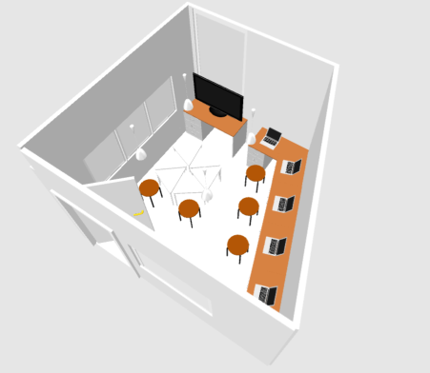
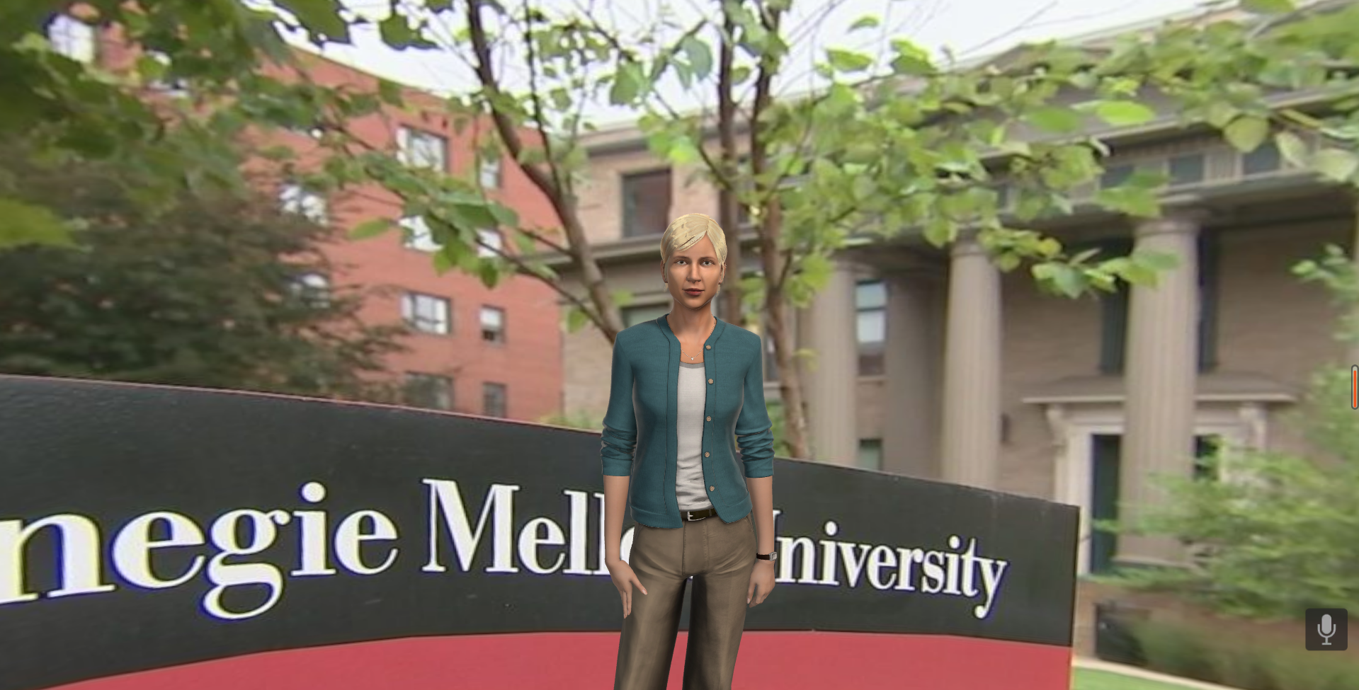
Real Environment
Sensors
Lorex Camera
Realsense Camera
Microphone
Array
· · ·
Other Sensors
USB / RTSP Protocol
Multimodal Stream Fusion
Microsoft PSI
Video/Audio Real-time Streaming data
Raw Data
Multimodal
Data Analysis
Data Cleaning
Interaction
Speech Recognition
Dataset
Agent Behavior Generation
Labels
Location Estimation
Dialog Generation
Behavioral
Information
Pose Estimation
Non-verbal Behavior Generation
· · ·
Behavior Commands
Other Submodules
Display and Feedback
Virtual Human Toolkit
Virtual
tutor

